Slide 1







Slide 2


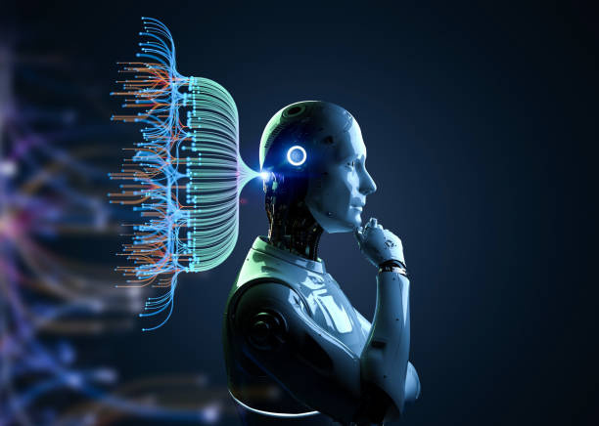

Key Components of an AI Agent
The key components of AI agents :
1. Brain - LLM’s
2. Memory
3. Tools

Slide 3

AI Brain
The “brain” of an AI agent is its reasoning and decision-making engine — typically a Large Language Model (LLM) or other machine learning model.
The “brain” helps with:
Understanding the request (“Is the customer asking for price or support?”).
Plans steps to achieve a goal
Making decisions (Which response or workflow should I follow?).
Orchestrates memory and tools.
Creating text or answers.

Slide 4

Memory & Knowledge Base
An agent is smarter if it can remember past conversations or look up information.
Memory stores information about previous steps or messages in a conversation, so the AI can refer back to them later.
Short-term memory:
Keeps track of the ongoing conversation
Short-term memory = data that exists only while the workflow is running.
Stored in node outputs
Stored in expressions
Lost after the workflow finishes

Slide 5
Memory & Knowledge Base
Long-term memory
Long-term memory = data stored outside the workflow, so it can be reused later.
Stores customer history, documents, FAQs in a database.
Tools: Pinecone, Chroma (vector databases).
Stored in:
Database (Postgres, MySQL)
Google Sheets
Vector DB (Chroma, Pinecone)

Slide 6


Tools & Actions
Tools are external systems or APIs that the agent can use to perform actions or get information beyond its own model.
Actions include:
Productivity: Sending emails, Calendar booking.
Data: Updating Google Sheets or CRMs (like HubSpot, Salesforce).
Search: Searching the web or fetching info from APIs.
Knowledge: Wikipedia, custom knowledge bases

Slide 7




